Slide 1
Master Thesis
Semantic Segmentation of Land Use with High-Resolution Orthophotos and Convolutional Neural Networks
Faculty of Mathematics and Computer Science
Chair of Computer Architecture
Karsten Köhler, Student ID No. 8690570

Slide 2
Content
Introduction, Research Question
Literature Review
Convolutional Neural Network
Reference Architectures
About the Dataset
Data, Labels, Preparation
Experiments
Implementation
Metrics, Results
Discussion
Spectral Vegetation Indices
Experiments
Discussion

Slide 3
Research Question
Background: Emergency Landing Assistant, Emergency Landing Field Identification
Main Objective: Semantic Segmentation of Land Use
Side Objective: Vegetation Density Analysis

Slide 4
Convolutional Neural Networks
Subset of Neural Networks
Highly efficient on grid-like data like e. g. images
Two common operations:
Convolution
Pooling

Slide 5
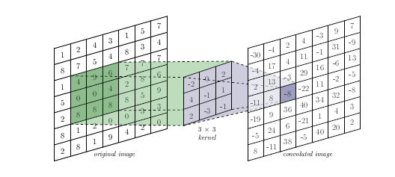
Convolution

Slide 6
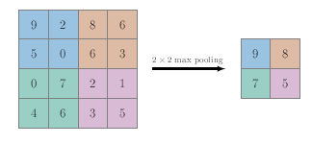
Pooling

Slide 7
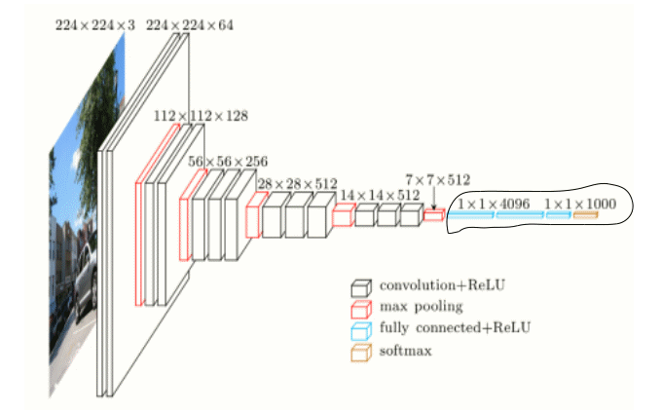
Example CNN Architecture

Slide 8
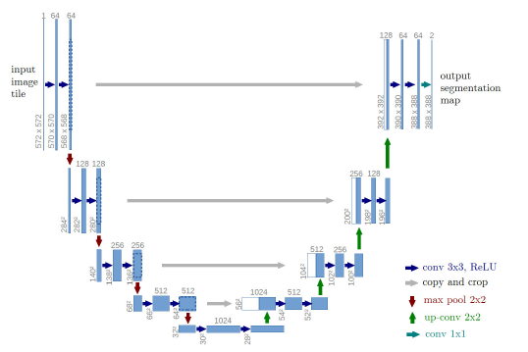
U-Net Architecture

Slide 9
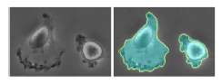
U-Net Metrics

Slide 10
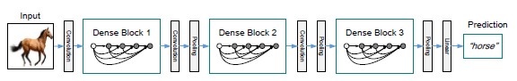
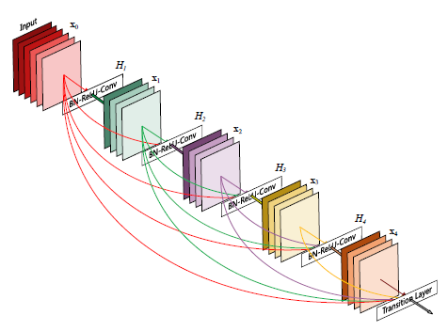
DenseNet Architecture

Slide 11
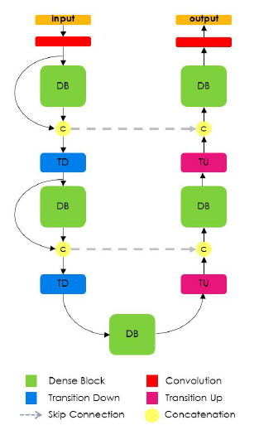
FC-DenseNet Architecture

Slide 12
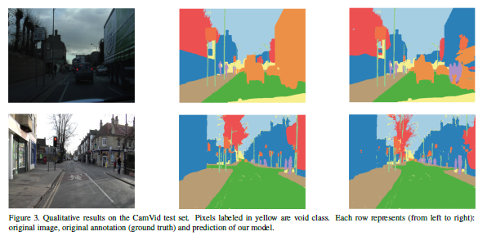
FC-DenseNet Metrics

Slide 13
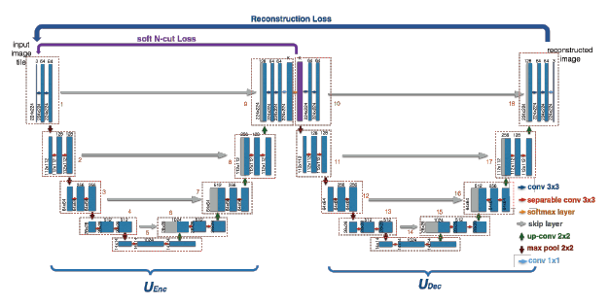
W-Net Architecture

Slide 14
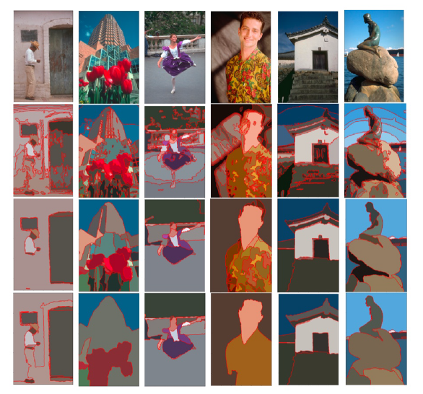
W-Net Metrics

Slide 15
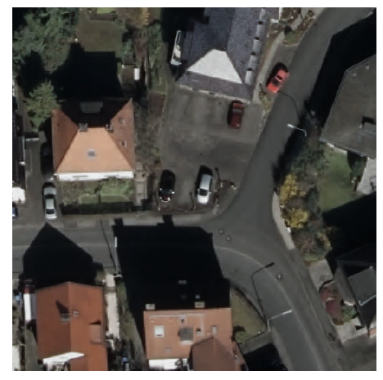
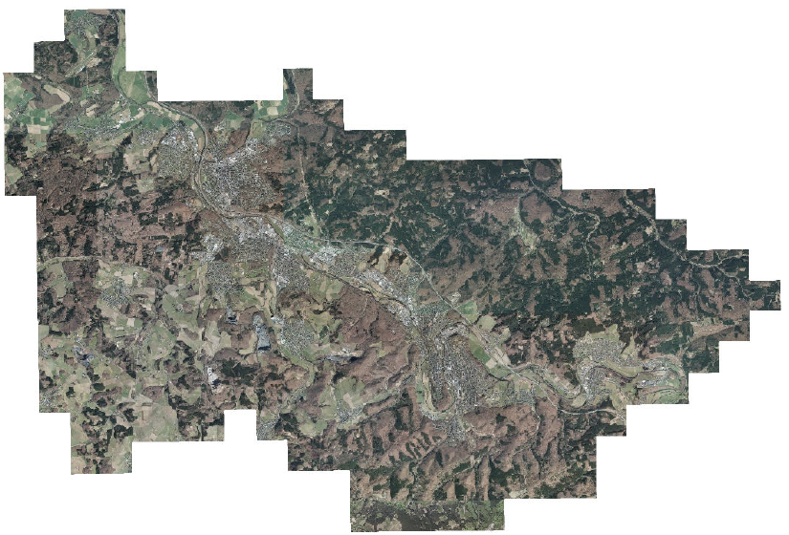
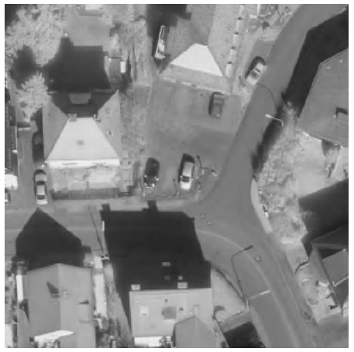
Digital Orthographic Photographs

Slide 16
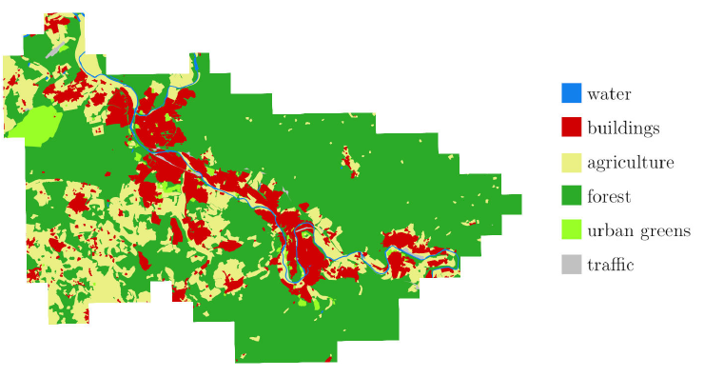
Vector Graphics with Land Use

Slide 17
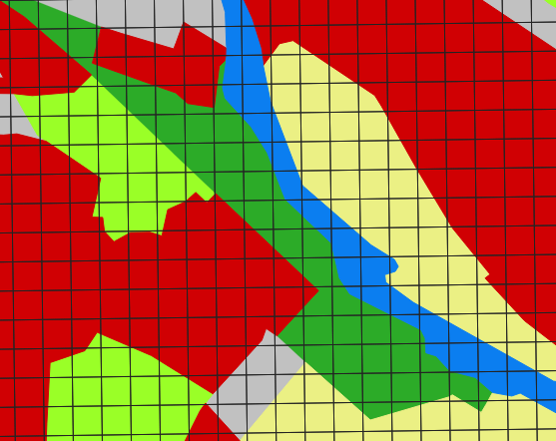
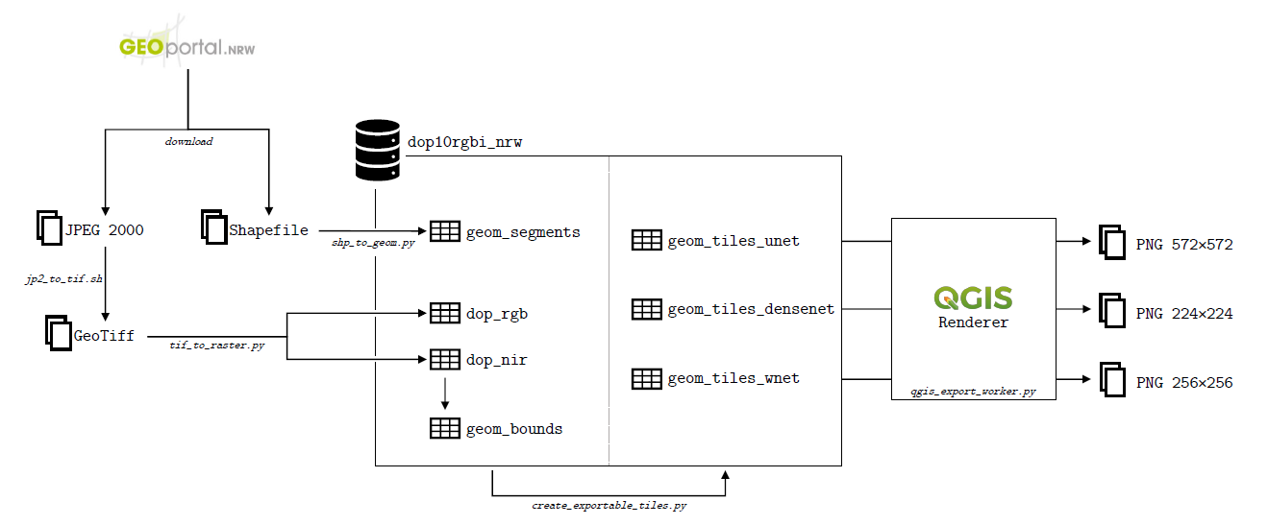
Preparations

Slide 18
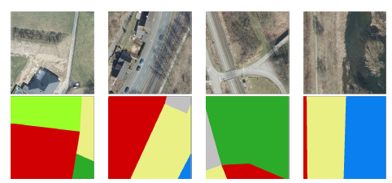
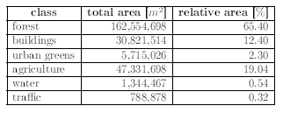
Considerations

Slide 19
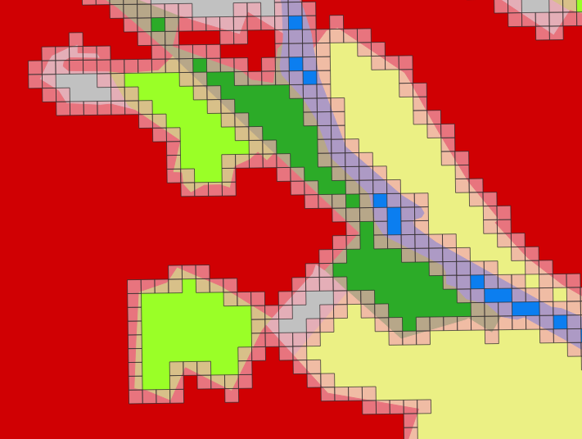
Class Imbalance
Many experiments with class weights -> no success

